Slide 1
Initial Setup Raspberry Pi
David Crook
@Data4Bots
Questions: dacrook@Microsoft.com

Slide 2
Agenda
The ‘me’ slide
Things to know
Goals
Content
Summary
Continuous Q&A

Slide 3

David Crook
Microsoft Developer Evangelist
Focused on Machine Learning and Embedded Systems
Enjoys challenges
Likes Fishing + Brazilian Jiu Jitsu
Typically not together
dacrook@Microsoft.com
(980)228-6278
@Data4Bots
www.indiedevspot.com

Slide 4
Stuff you should Know About
Additional Resources
Channel9: http://channel9.msdn.com
Hackster: https://www.hackster.io
Stack Overflow: http://electronics.stackexchange.com/
BizSpark
Free Azure
Free Tools Network Partner Give to your startups for free
Microsoft Innovation Center
Hack Tuesdays: Mentoring every Tuesday 11am – 4pm
Free Co-Working for Startups: dacrook@Microsoft.com to apply
Free Training: See schedule here: http://indiedevspot.com/events/

Slide 5
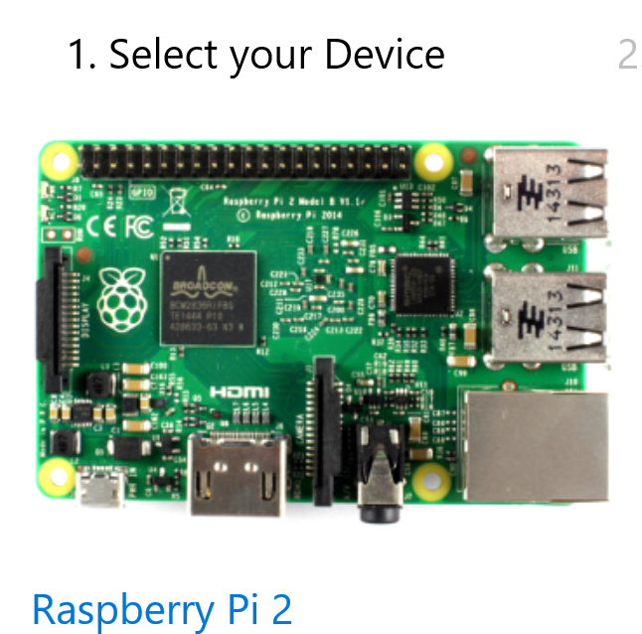
Future Reference Getting Started
http://ms-iot.github.io/content/en-US/GetStarted.htm

Slide 6
Goals of Presentation
Understanding the Pi
Installing Windows 10 IoT Core
Power Considerations
Wi-Fi Options
PowerShell Setup

Slide 7
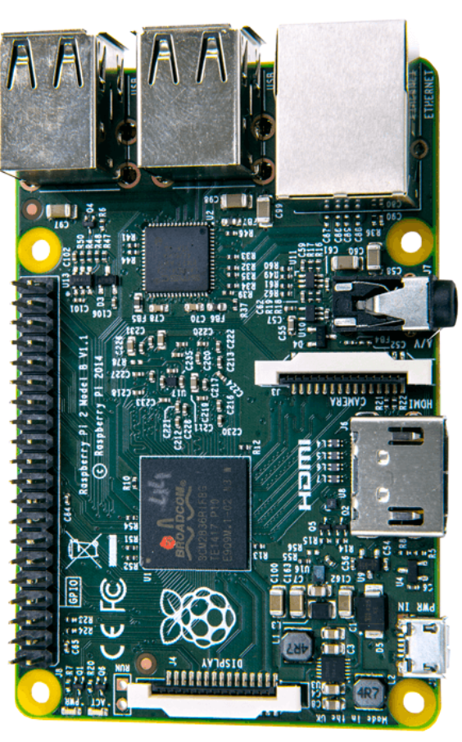
What is the Raspberry Pi?
Full System
Lots of CPU & Memory
GPIO
Versatile
Compared to Arduino
No ADC built in – need peripherals
More power
More capabilities
Ease of development

Slide 8
What is Windows 10 IoT Core
Scaled down version of Windows 10
Has GPIO and low level functions
Foreground App vs Background App
Why not Raspbian
UWP
Visual Studio Debugging
Additional Languages and Packages

Slide 9

Why do I care about them?
Power
IoT
Development Tools
Languages
Libraries
Visual Studio
Dev Ops Tool Chain
Visual Studio
Build

Slide 10

Wi-Fi Options
Official Raspberry Pi Dongle
Simple setup
Possible issues if multiple on same network (all are default named minwinpc)
Ethernet Adapter (included in PG Kits)
More difficult setup
More robust setup

Slide 11
PowerShell Setup
Headless
No UI, No Keyboard
Ethernet Adapter
Comes with PG Kit
Official dongles are nearly impossible to get.
Remember Power Considerations
USB power packs might supply 5V, but maybe not enough Amps

Slide 12
Connect Everything
Supply Pi with Power
Connect Ethernet Cable to Adapter to USB into laptop

Slide 13
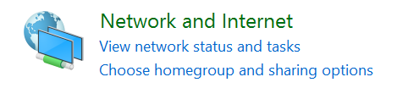
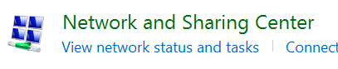
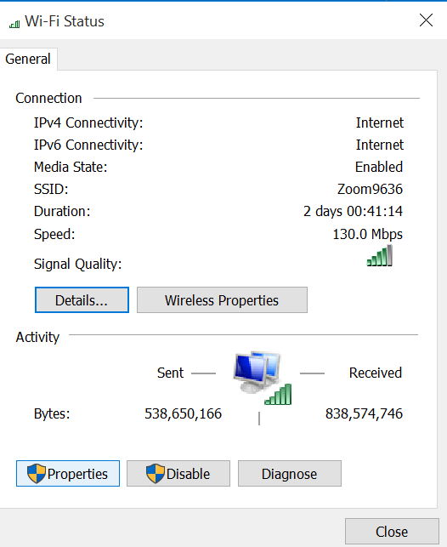
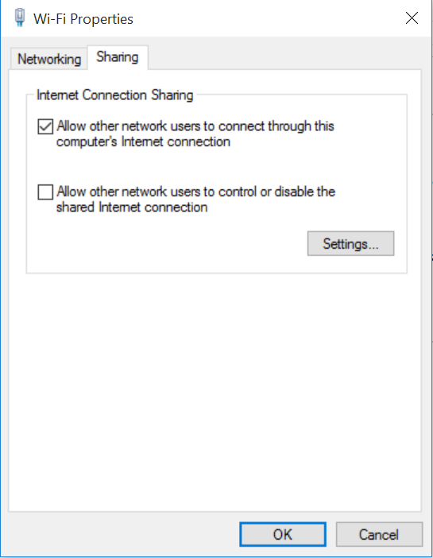
Enabling Wi-Fi Bridging
Open Control Panel
Navigate to Network and Internet
Navigate to Network & Sharing
Click Wifi (or internet connected interface)
Go to Properties
Sharing
Select Sharing
Click “Allow other network users to connect”
Notes:
Possible Reasons you may not have sharing tab:
You do not have another network interface attached that can be detected (check your pi to laptop wiring to ensure it is connected properly)
You are on a corporate box in which the group policy blocks this sort of thing. See Appendix for fixing the issue or reference stack overflow article: http://stackoverflow.com/questions/33483188/bridge-wifi-to-raspberry-pi-using-ethernet-cable

Slide 14
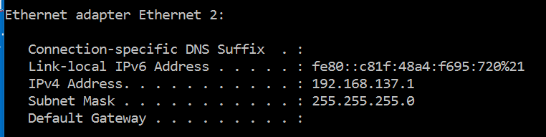
Networking Magic
Get your ip address for the Ethernet Interface
Open a cmd prompt on your laptop and type “ipconfig”
Look for Ethernet.
Write down your ip

Slide 15
Modifying your Pi’s network settings
#use to powershell into pi the first time
Set-Item WSMan:\localhost\Client\TrustedHosts -Value minwinpc
Enter-PSSession -ComputerName minwinpc -Credential minwinpc\Administrator
#use to powershell into pi after you set static ip address
Set-Item WSMan:\localhost\Client\TrustedHosts -Value YourIP+1
Enter-PSSession -ComputerName YourIP+1 -Credential YourIP+1\Administrator
#Need unrestricted cmd access
set-executionpolicy unrestricted
#run each of these commands once. Sets static ip, dns and shows configuration
netsh int ip set address "Ethernet" static YourIP+1 255.255.255.0 YourIP
netsh int ip set dns "Ethernet" static 8.8.8.8
netsh interface ipv4 show config
#finish by setting our execution policy back to normal
set-executionpolicy remotesigned
#reboot pi
Notes:
Enter these commands into an elevated powershell prompt.
Get to PowerShell – Seach in the Win10 search thing for “PowerShell” right click and run as administrator.
Your IP + 1 means if your ip is 192.168.137.1, then the ip should be 192.168.137.2
If can’t ping google.com after running through this, power off the pi, wait 10 seconds, power pi back on. Login to pi again, and check configuration and try pinging google.com again.
We are giving the raspberry pi a static ip address, this is normally set by a dhcp server and a default gateway of your laptop (this routes traffic)
After which, we need name resolution for access to IoT hub or to call say google.com
8.8.8.8 is the google dns server. By using this, we are able to route traffic properly using names.
When all of this is done, the user should be able to ping google.com from inside the Pi’s powershell session.

Slide 16
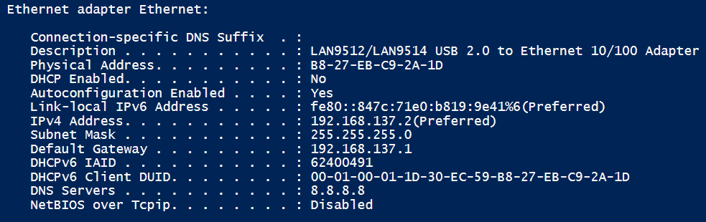
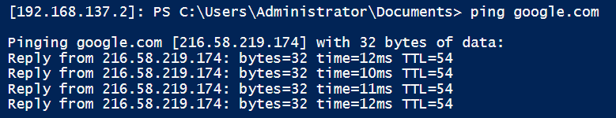
You should see

Slide 17
What Next?

Slide 18

Download the tools!
Visual Studio 2015
Create functions for:
Left
Right
Forward
Back

Slide 19

Control a Sprinkler System!

Slide 20
There is more!

Slide 21

Brown Bag Series
Electronics 101
3 Rotating Sessions
IoT 101
3 Rotating Sessions
Machine Learning 101
2 Rotating Sessions
3D Printing 101
Just 1 session!

Slide 22
Questions?

Slide 23
dacrook@Microsoft.com
(980)228-6278
@Data4Bots
www.indiedevspot.com

